Slide 1
Final Project
Predicting Home Sale Price Using ML in Montgomery County, MD

Slide 2
Flow of Presentation
Swapna - Introduction , One Year Model Data Gathering and Evaluation
Rakan - Five Year Model Data Visualization and Tableau Storytelling
Adam - Five YearModel Data Gathering ,Data Visualization and Tableau Storytelling
Nicole - Five Year Model Evaluation, Insights and Conclusion

Slide 3
Problem Statement
Why This Problem
Predict the sale price of a house in Montgomery County, MD based on a variety of attributes.
Home ownership - biggest financial decision.
Has practical applications - a web application could be created for potential buyers or sellers to predict fair market price of houses on sale
Interesting problem to collect and analyze data - supervised learning can be used easily since prior home sales data is available
Interesting to explore factors affecting home prices
Scale of data is just right. Each year, approximately ~15K houses are sold in Montgomery County, MD
Montgomery County, MD is a diverse geographical location covering all types of communities such as rural, suburban and urban with a total population of around 1M. This would eliminate any potential biases from analysis

Slide 4
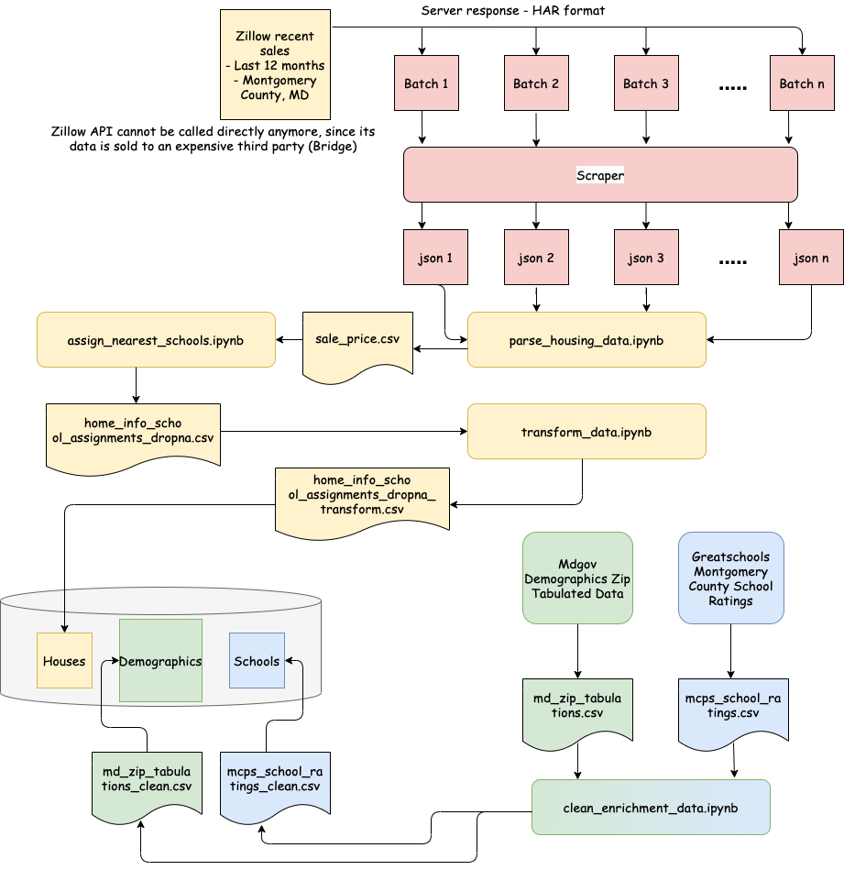
Data Collection for 1 year model

Slide 5
Questions To Be Answered
01
02
03
TYPICAL SALE PRICE
DOMINANT FACTORS
MODEL ACCURACY
04
05
06
OUTLIERS
FURTHER IMPROVEMENTS
PATTERNS
What is the typical sale price in Montgomery County, MD
What are the most dominant factors affecting the sale price
Have we collected enough attributes to be able to make accurate predictions?
If there are outliers, what causes them?
Can we collect further enrichment data to increase the model accuracy?
Can we uncover some other patterns outside of our stated problem?

Slide 6
Data Exploration : Features
Location (lat, lng) → for visualization
School Location → for visualization
Zipcode → for matching
Sale price → target
Name → for matching
% ethnic breakdown
# bedrooms, bathrooms → feature
Type → Elementary, middle, high
Area, lot size in sq feet → feature
Rating → matched column
House type, year built → feature
Elementary, middle, high school rating → feature
% ethnicities in zipcode → feature

Slide 7
Results : ML for one year Model
 | Base Model | Model With School Ratings Enrichment | Model With School and Demographics Enrichment
Multiple Linear Regression | R² = 0.66, MSE = 55.1 * 10⁹ | R² = 0.76, MSE = 38.1 * 10⁹ | R² = 0.78, MSE = 35.1 * 10⁹
Random Forrest (30 Features) | R² = 0.72, MSE = 45.5 * 10⁹ | R² = 0.88, MSE = 18.6 * 10⁹ | R² = 0.9, MSE = 16.1 * 10⁹
More enrichment data, more features for random forrest regressor
R² improved from 0.66 to 0.9
MSE reduced from 55.1 to 16.1

Slide 8
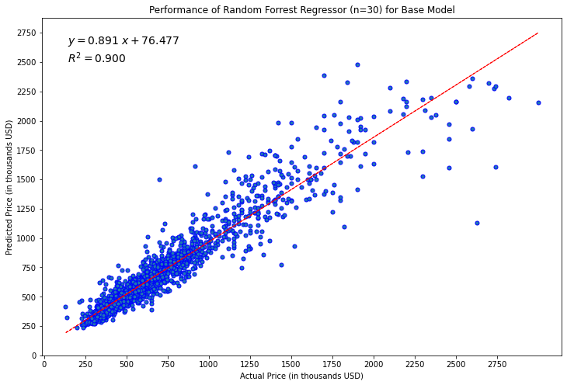
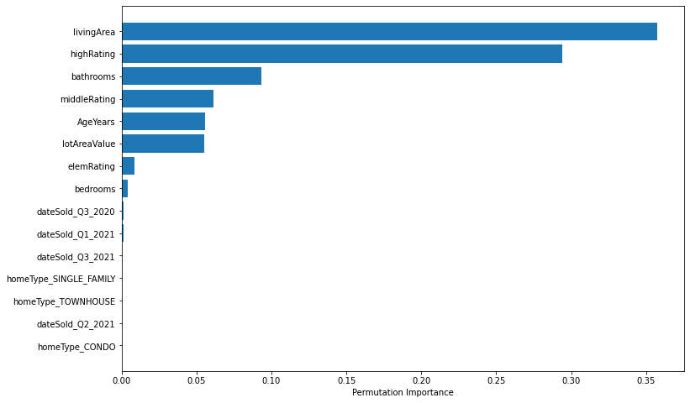

Slide 9
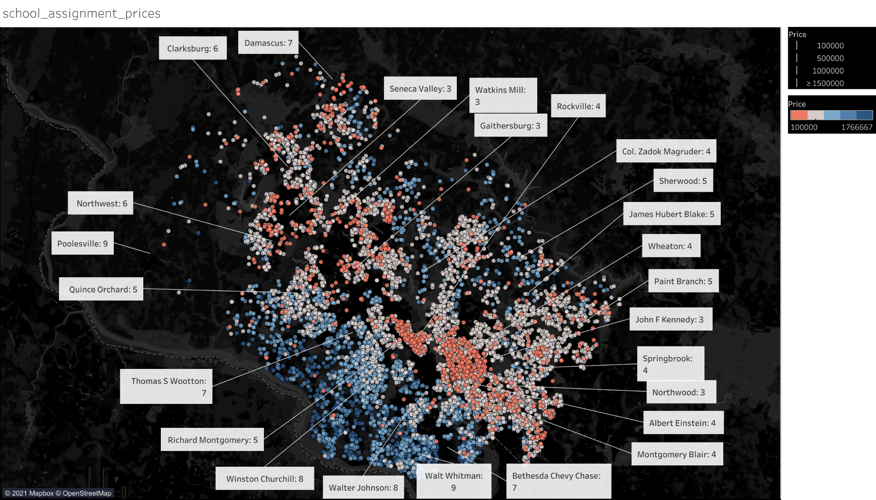

Slide 10
School District Ratings
Metro Information
Transportation
Inflation Rates
Demographics
Expanding the Analysis

Slide 11
Conclusions
People are moving away from urban centers
Houses are staying on the market for significantly less time
Prices are going up but not at a disproportionate rate
Busy season for buying is slowly changing

